Slide 1
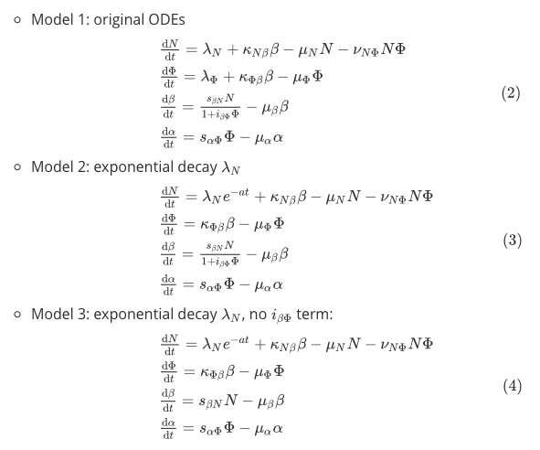
Models

Slide 2
1. Uniform prior [1e-6, 75] and [1e-6, 25]
2000 particles per generation
30 generations
6 hrs wall time
Multivariant normal kernel

Slide 3
model 1, uniform [1e-6, 75]
eps_t: 38.28 (t=24*)
model 2, uniform [1e-6, 75]
eps_t: 38.06 (t=25*)
model 3, uniform [1e-6, 75]
eps_t: 37.06
*: killed because of exceeding 6 hrs wall time

Slide 4
model 1, uniform [1e-6, 25]
eps_t: 38.72
model 2, uniform [1e-6, 25]
eps_t: 35.25
model 3, uniform [1e-6, 25]
eps_t: 26.99

Slide 5
Model selection: model 3
uniform [1e-6, 75]
uniform [1e-6, 25]

Slide 6
Parameters’ estimation of the selected model
name, inter-quartile, mean
name, inter-quartile, mean
lambda_n, [21.343, 54.868], 37.937
a, [24.235, 54.365], 38.819
k_n_beta, [36.638, 61.779], 48.231
mu_n, [27.226, 49.275], 37.973
v_n_phi, [0.212, 0.375], 0.308
k_phi_beta, [0.339, 0.741], 0.665
mu_phi, [0.205, 0.537], 0.475
s_beta_n, [22.540, 47.342], 35.299
mu_beta, [27.501, 55.941], 41.467
mu_alpha, [35.924, 60.845], 47.793
s_alpha_phi, [18.620, 40.774], 30.565
lambda_n, [9.199, 19.262], 14.156
a, [4.340, 14.401], 9.670
k_n_beta, [15.084, 21.646], 18.001
mu_n, [9.760, 16.786], 13.196
v_n_phi, [0.404, 0.958], 0.742
k_phi_beta, [0.191, 0.280], 0.239
mu_phi, [0.120, 0.188], 0.154
s_beta_n, [3.196, 8.782], 6.752
mu_beta, [2.826, 8.501], 6.378
mu_alpha, [13.503, 21.345], 16.997
s_alpha_phi, [8.269, 15.246], 11.859
dN/dt
dɸ/dt
dβ/dt
dα/dt
model 3, uniform [1e-6, 75]
eps_t: 37.06
model 3, uniform [1e-6, 25]
eps_t: 26.99

Slide 7
2. Log uniform prior [1e-6, 75], [1e-6, 25] and [1e-6, 50]
2000 particles per generation
30 generations
6 hrs wall time
Multivariant normal kernel

Slide 8
model 1, log uniform [1e-6, 75]
eps_t: 24.23
model 2, log uniform [1e-6, 75]
eps_t: 33.53
model 3, log uniform [1e-6, 75]
eps_t: 19.59

Slide 9
model 1, log uniform [1e-6, 50]
eps_t: 20.24
model 2, log uniform [1e-6, 50]
eps_t: 22.37
model 3, log uniform [1e-6, 50]
eps_t: 18.53

Slide 10
model 1, log uniform [1e-6, 25]
eps_t: 22.65
model 2, log uniform [1e-6, 25]
eps_t: 26.49
model 3, log uniform [1e-6, 25]
eps_t: 19.73

Slide 11
Model selection
log uniform [1e-6, 25]
log uniform [1e-6, 75]
log uniform [1e-6, 50]

Slide 12
Parameters’ estimation of the selected model
name, inter-quartile, mean
name, inter-quartile, mean
lambda_n, [15.036, 16.148], 15.589
k_n_beta, [0.027, 0.071], 0.050
mu_n, [0.067, 0.128], 0.097
v_n_phi, [0.132, 0.145], 0.139
lambda_phi, [0.067, 0.156], 0.115
k_phi_beta, [0.109, 0.124], 0.117
mu_phi, [0.034, 0.046], 0.040
s_beta_n, [0.948, 1.227], 1.096
i_beta_phi, [0.182, 0.266], 0.224
mu_beta, [0.441, 0.518], 0.481
mu_alpha, [1.817, 2.172], 1.995
s_alpha_phi, [0.838, 1.053], 0.945
lambda_n, [12.679, 14.051], 13.296
a, [0.015, 0.020], 0.017
k_n_beta, [0.119, 0.358], 0.259
mu_n, [0.010, 0.024], 0.018
v_n_phi, [0.113, 0.144], 0.131
k_phi_beta, [0.146, 0.166], 0.156
mu_phi, [0.028, 0.041], 0.035
s_beta_n, [1.086, 1.317], 1.213
mu_beta, [1.167, 1.437], 1.315
mu_alpha, [3.970, 7.225], 5.826
s_alpha_phi, [1.762, 2.953], 2.434
dN/dt
dɸ/dt
dβ/dt
dα/dt
model 1, log uniform [1e-6, 75]
eps_t: 24.23
model 3, log uniform [1e-6, 25]
eps_t: 19.73

Slide 13
Findings
When using log uniform prior distribution, prior range does not affect the result much, the estimated values of parameter are smaller than ones from uniform distribution. The final epsilon (after 30 generations) ε_t is also smaller.
Using uniform prior distribution and large range could result in the algorithm leading to a local optima, when we demanding a smaller epsilon it could cost huge amount of time to find enough particles, i.e. the last generations have very low acceptance rates (<10⁻³). E.g., the execution time of all these runs is less than 3 hrs, except two runs which exceeded the 6 hrs wall time (’*’ in page 3)

Slide 14
model 4, log uniform [1e-6, 50]
eps_t: 20.03
model 5, log uniform [1e-6, 50]
eps_t: 17.33

Slide 15
factors applied:
first 8 data points: f=0.75
next 4 data points: f=0.25
model 4, log uniform [1e-6, 50]
eps_t: 17.49

Slide 16
model 3, log uniform [1e-6, 50]
eps_t: 19.96
model 4, log uniform [1e-6, 50]
eps_t: 22.95
model 5, log uniform [1e-6, 50]
eps_t: 16.83
population size = 5000

Slide 17
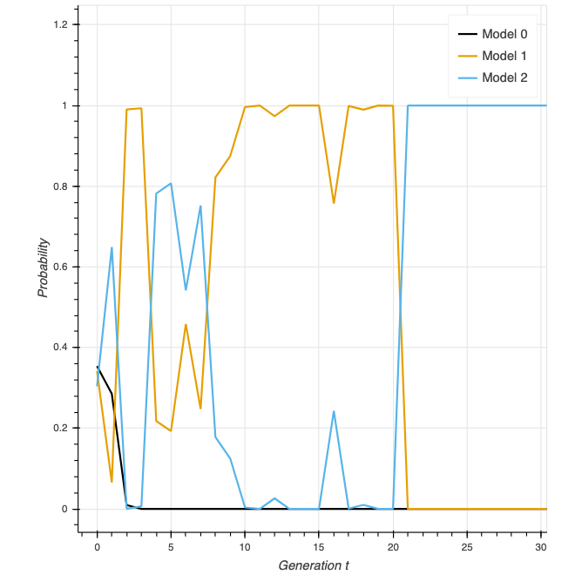
Larger size model selection

Slide 18
PCA for sensitivity (model 5)

Slide 19
PCA for sensitivity (model 5)
Also see:
parameters credible intervals
joint posterior distribution
Model 5 is most sensitive to parameters with large portion

Slide 20

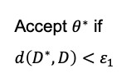
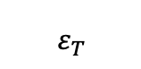
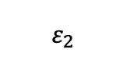
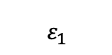
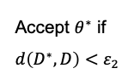

prior
population 1
population 2
population T
sample
perturb
...
Accept $θ^{∗}$ if $d\left(D^{∗},D\right)<ε_{1}$
Accept $θ^{∗}$ if $d\left(D^{∗},D\right)<ε_{2}$
$$θ$$
$$θ^{∗}$$
$$ε_{1}$$
$$ε_{2}$$
$$ε_{T}$$

